Slide 1

Canadian Confederation

Slide 2
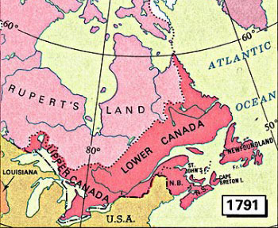
Background to Union:
Lower Canada
  French speaking
  Catholic
Upper Canada
  English speaking
  Protestant
Each part of the Province of Canada was given equal representation and both resented it
Was considered dysfunctional by almost everyone
  Rebellions in both halves in 1838

Slide 3
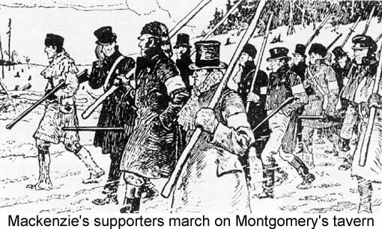
Rebellions of 1838:
Upper Canada
  Political corruption and allegations of patronage plagued the government
  Reformers had been unsuccessful in changing the system
    Robert Baldwin
  William Lyon Mackenzie led open rebellion in an attempt to overthrow the government

Slide 4
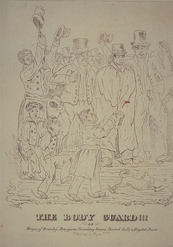
Rebellions1838:
Lower Canada
  Was upset about representation in the legislature
  This forced tensions as petitions were signed and ignored by the British
  Patriots took up arms to ensure that the British would capitulate
  The British Response was to burn villages loyal to the Patriots

Slide 5
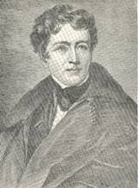
Durham Report:
Lord Durham was dispatched from England to determine why the rebellions had happened
He made three recommendations:
  Responsible government be granted to the British North American colonies
  Upper and Lower Canada be amalgamated to form a united Province of Canada
  Finally that French Canadians should be assimilated by the English Majority

Slide 6
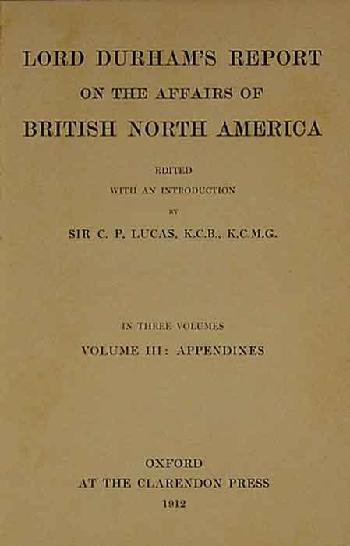
Results of the Rebellions and Durham’s Reaction:
Distrust of the English Canadians by the French Canadians
Dysfunctional union where nether side had the political control to effectively govern nor the desire to compromise

Slide 7
The Road to Confederation:
Political Reasons
  Unhappy population
Common enemies
  Britain/America
Similar laws
  All were colonies
Economic depression
  Lack of success in other unions
Desire to enhance transportation links
  Rail lines
Canada a North American Nation?
America
  Civil war
  Manifest destiny

Slide 8
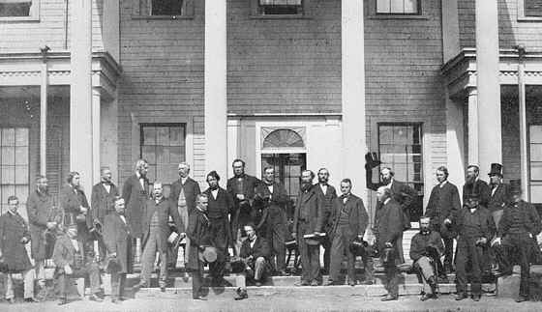
Charlottetown Conference:

Slide 9
Charlottetown Conference
September 1, 1864
The original purpose of this conference was to discuss a union of the Maritimes
The Canadian delegation was able to convince the Maritimers that confederation would be beneficial to the Maritimes
This delegation was able to achieve agreement on the general sentiment of confederation
The specifics were then debated and discussed and the Quebec Conference

Slide 10
Quebec Conference
October 10, 1864
This was a conference designed to come to a formal agreement on what specific shape of Confederation would take
Written agreements
There were several areas of debate and opposition:
  Division of powers federal and provincial
  Representation for the different colonies in the Legislature
  Bicameral powers

Slide 11
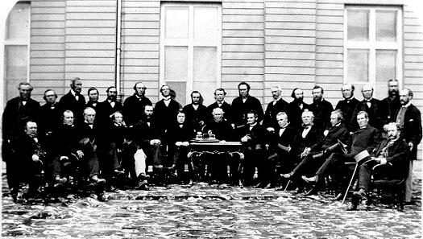

Slide 12
The Long Three Years to
July 1, 1867
While the Quebec conference was considered a success there were several ‘details’ to be worked out
  The British legislature needed to ratify the constitution
  Also there was limited support at home
    Upper Canada supported the agreement
    Lower Canada was split on the agreement
    New Brunswick held a vote on Confederation and lost

Slide 13
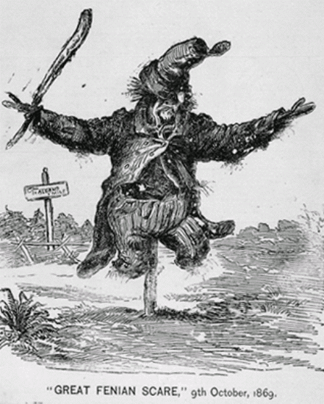
External Pressure:
British
  The British Government lent quick support to the union
  Stating publicly that they would pass the necessary legislation quickly
  They also offered to host a conference
American
  The cancellation of a trade agreement with New Brunswick severely hurt the economy
  Fenian Raids
  Manifest Destiny

Slide 14
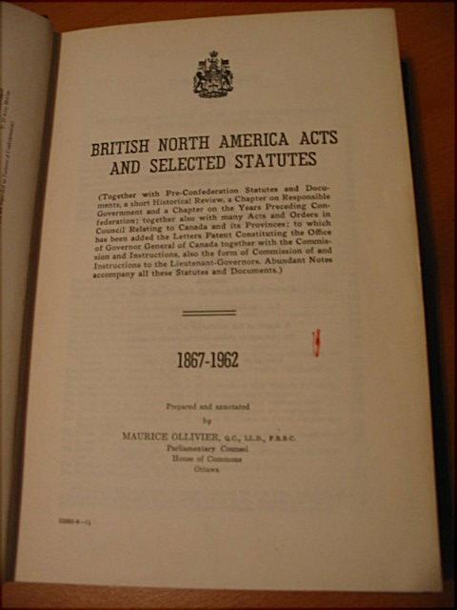
London Conference
December-March 1867
Uneventful conference and ‘Quick’ passage of the legislation
Queen Victoria signs the bill on March 29 1867
BNA Act comes into effect on July 1, 1867

Slide 15
